Slide 1


Attacking Face Recognition With T-Shirts: Database, Vulnerability Assessment, and Detection
Authors: MATHIAS IBSEN,CHRISTIAN RATHGEB, FABIAN BRECHTEL, RUBEN KLEPP, KATRIN PÖPPELMANN, ANJITH GEORGE ,SÉBASTIEN MARCEL AND CHRISTOPH BUSCH
Presented by: Rohit Kumar
Scholar No: 24204041120
Course: M. Tech in Agile Software Engineering
Published Date:5/06/2023
Published in IEEE Acess.
Type: Journal

Slide 2
Contents
Introduction
T-Shirt Presentation Attack
T-Shirt Face Presentation Attack (TFPA) Database
Vulnerability Assessment of Face Recognition Systems
Proposed Detection Methods
Evaluation and Results
Discussion and Conclusion

Slide 3
Introduction to Face Recognition and Presentation Attacks (PAs)
Face Recognition: It widely used in personal, industrial, and governmental security applications.
Presentation Attacks (PAs): Attempts to deceive biometric systems by presenting modified or artificial input (e.g., printed images, masks).
Challenge: Performance can drop with changes in lighting, angles, occlusions (e.g., sunglasses, masks), or low image quality, making it difficult to recognize faces consistently.

Slide 4
T-Shirt Presentation Attack
Concept: Using T-shirts with printed faces to fool face recognition systems.
Motivation: Such T-shirt-based attacks are low-cost, easy to conceal, and can bypass face recognition systems.
Goal of Study: Assess the vulnerability of face recognition systems to T-shirt PAs and propose detection methods.

Slide 5
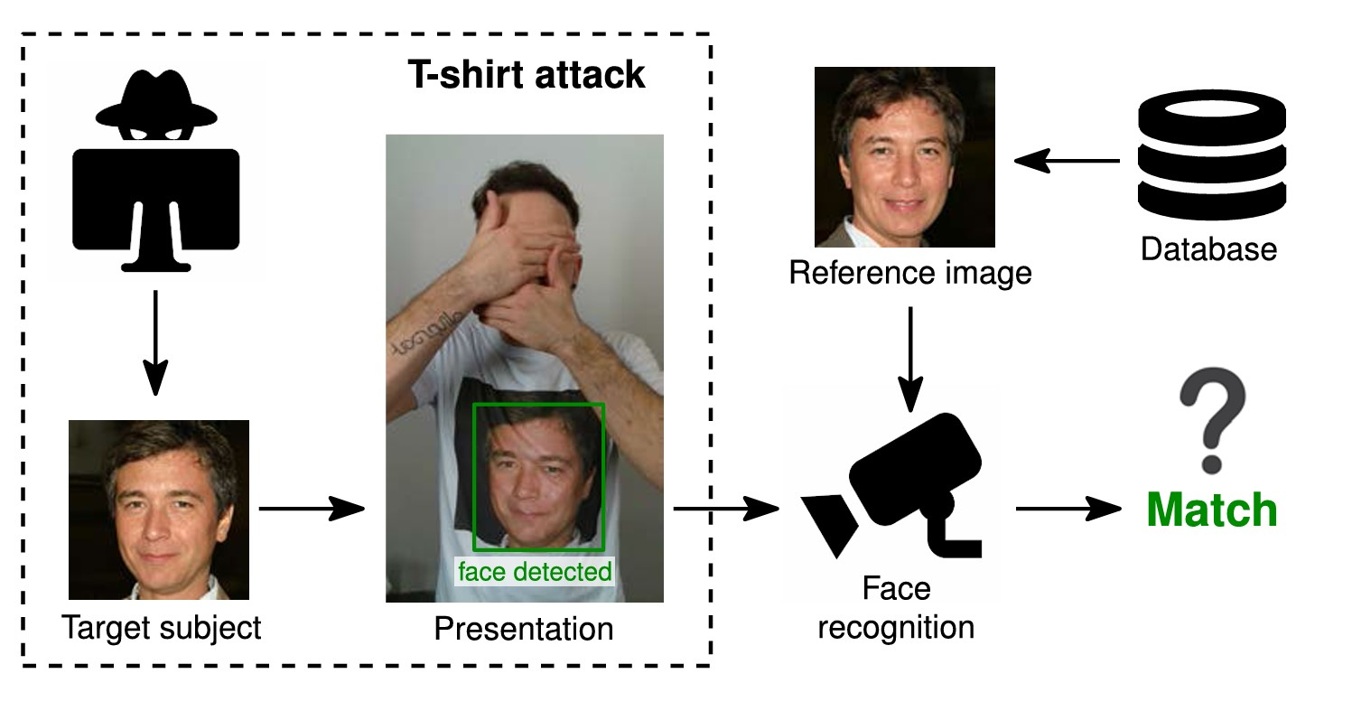
T-Shirt Presentation Attack
Figure 1. Can T-shirts with faces printed on them be used to attack face recognition systems?

Slide 6
T-Shirt Face Presentation Attack (TFPA) Database
Database Details
Capturing Scenarios
Significance

Slide 7
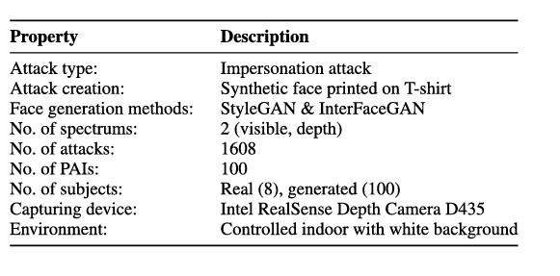
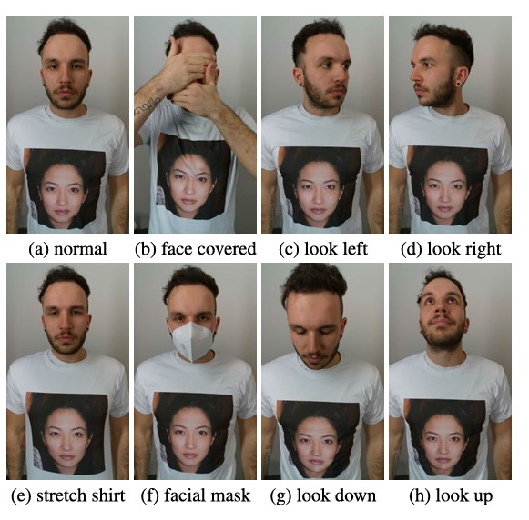
Database Details
Capturing Scenarios
Table 1. An overview of the proposed T-shirt face presentation attack (TFPA) database.
FIGURE 2. The eight different capturing scenarios.

Slide 8
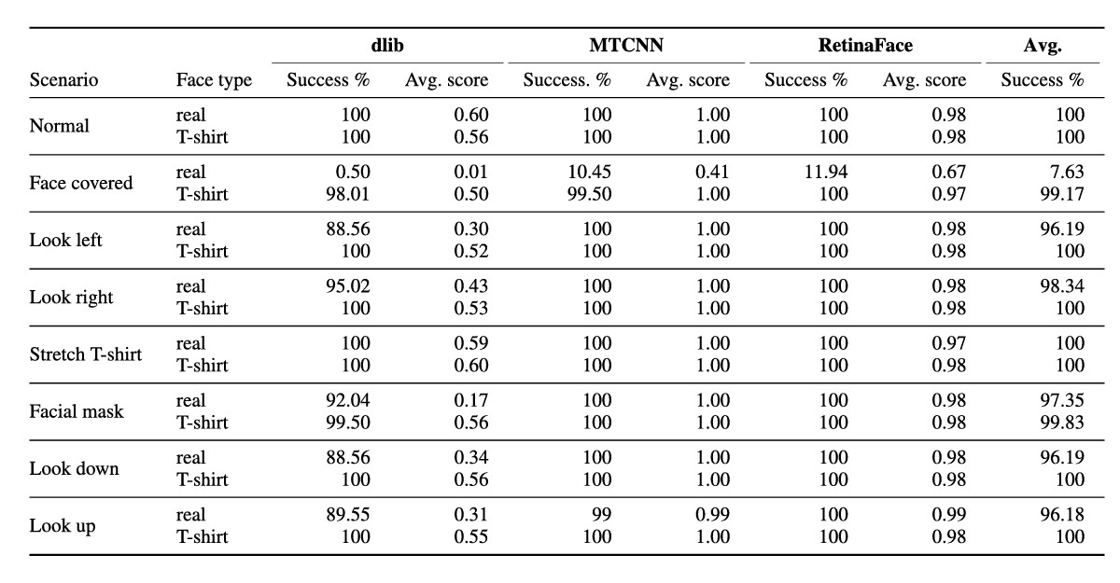
Results:
To evaluate this, three open-source algorithms were used, namely RetinaFace [6], MTCNN [7], and dlib [5]
The results for each capturing scenario and algorithm are summarized in table 2.
The results show that the T-shirt faces are successfully detected in almost all cases with an average estimated detection rate for the three algorithms > 99% across all eight poses.
Table 2. Detection accuracy and average detection scores across algorithms and capturing scenarios for T-shirt and real faces.

Slide 9
Vulnerability Assessment of Face Recognition Systems
Many face detection algorithms can detect faces on T-shirts as real faces.
High Impostor Attack Presentation Match Rate (IAPMR) > 92.6%
Both open-source and commercial systems show high vulnerability, especially in scenarios where attackers conceal their real faces.

Slide 10
Proposed Detection Methods
Depth Map Analysis
Anomaly Detection
Fusion Approach

Slide 11
Experimental Setup and Matrics
Training and Testing: DV and AD models were trained on controlled reference images and more uncontrolled probe images from the FRGCv2 [8] database.
Matrics
Attack Presentation Classification Error Rate (APCER): Measures the proportion of attacks incorrectly classified as real. means system incorrectly detect fake face is real.
Bona Fide Presentation Classification Error Rate (BPCER): Measures the proportion of real images wrongly classified as attacks. Its recognize real face is fake.

Slide 12
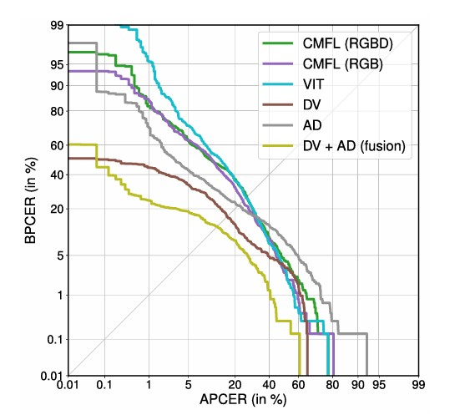
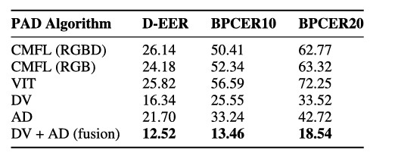
Evaluation and Results:
TABLE 2. D-EER, BPCER10, and BPCER20 in % for the different PAD algorithms.
FIGURE 3. DET curves showing PAD performance on TFPA.

Slide 13
Discussion
Challenges in Detection:
a. Variability in detection across RGB and depth data.
b. Difficulties with generalizing to unknown attack types.
Potential Future Solutions: Explore new datasets and more adaptive PAD systems

Slide 14
Reference
[1] J. Deng, J. Guo, N. Xue, and S. Zafeiriou, ‘‘ArcFace: Additive angular margin loss for deep face recognition,’’ in Proc. IEEE/CVF Conf. Comput. Vis. Pattern Recognit. (CVPR), Jun. 2019, pp. 4685–4694.
[2] Q. Meng, S. Zhao, Z. Huang, and F. Zhou, ‘‘MagFace: A universal representation for face recognition and quality assessment,’’ in Proc. IEEE/CVF Conf. Comput. Vis. Pattern Recognit. (CVPR), Jun. 2021, pp. 14220–14229.
[3] R. Raghavendra, K. B. Raja, and C. Busch, ‘‘Presentation attack detection for face recognition using light field camera,’’ IEEE Trans. ImageProcess., vol. 24, no. 3, pp. 1060–1075, Mar. 2015.[23]
[4] C.Chen,A.Dantcheva,T.Swearingen,andA.Ross,‘‘Spoofingfacesusing makeup: An investigative study,’’ in Proc. IEEE Int. Conf. Identity, Secur. Behav. Anal. (ISBA), Feb. 2017, pp. 1–8. [36]
[5] D. King, ‘‘Dlib-ml: A machine learning toolkit,’’ J. Mach. Learn. Res., vol. 10, pp. 1755–1758, Dec. 2009. [51]
[6] J. Deng, J. Guo, E. Ververas, I. Kotsia, and S. Zafeiriou, ‘‘RetinaFace: Single-shot multi-level face localisation in the wild,’’ in Proc. IEEE/CVF Conf. Comput. Vis. Pattern Recognit. (CVPR), Jun. 2020, pp. 5202–5211. [53]
[7] K.Zhang,Z.Zhang,Z.Li,andY.Qiao,‘‘Jointfacedetectionandalignment using multitask cascaded convolutional networks,’’ IEEE Signal Process. Lett., vol. 23, no. 10, pp. 1499–1503, Oct. 2016. [52]
[9] Information Technology Biometric Presentation Attack Detection—Part 3: Testing and Reporting, Standard ISO/IEC JTC1 SC37 Biometrics, ISO/IEC 30107-3, International Organization for Standardization, 2017. [56]
[10] C. Lugaresi, J. Tang, H. Nash, C. McClanahan, E. Uboweja, M. Hays, F. Zhang, C.-L. Chang, M. G. Yong, J. Lee, W.-T. Chang, W. Hua, M. Georg, and M. Grundmann, ‘‘MediaPipe: A framework for perceiving and processing reality,’’ in Proc. 3rd Workshop Comput. Vis. AR/VR IEEE Comput. Vis. Pattern Recognit. (CVPR), Jun. 2019, pp. 1–4. [57]
[8] P. J. Phillips, P. J. Flynn, T. Scruggs, K. W. Bowyer, J. Chang, K. Hoffman, J. Marques, J. Min, and W. Worek, ‘‘Overview of the face recognition grand challenge,’’ in Proc. IEEE Comput. Soc. Conf. Comput. Vis. Pattern Recognit. (CVPR), Jun. 2005, pp. 947–954. [54].

Slide 15
THANK YOU

Slide 16

Questions

